Slide 1
Open MRS. Com Group:-4 (232 Testing SL Batch)

Slide 2
GROUP MEMBERS
2575816(Team Lead) | Priyanshu Dwivedi
2576485 | Kalal Abhilash
2576338 | Darshan K J
2576391 | Shivam Singh
2577199 | Suraj S Malwankar
2576681 | Thummaginjala Siva Prasad
2576047 | Mucherala Mallika
2576986 | Thangellapally Bharath Kumar
2576275 | Padarthi Siri Manasa

Slide 3
CONTENT
1. INTRODUCTION
2. PROJECT MODULES
3. TECHNOLOGIES USED
4. SCREENSHOTS

Slide 4
Introduction
Today I will introduce you to a comprehensive solution that aims to transform the way we can automate the open MRS website using different automation tools
URL - https://demo.openmrs.org/openmrs/login.htm

Slide 5
PROJECT MODULES
Functionalities Performed
- Navigate to the URL, Perform Login operation.
- Perform Register a Patient.
- Find Patient Record by (ID or Name).
- Perform Capture Vitals for Patient.
- Select any Patient and Record the Vitals.
- Perform Manage service types and Add New service types.
- Choose Patient and Perform the Patient Appointments.
- Create Appointment Blocks.
- Find Patient Record and Click on Registration.

Slide 6



TECHNOLOGIES USED
1. SELENIUM
2. TESTNG
3. CUCUMBER
4. JAVA

Slide 7
Automation Testing
- refers to the practice of using software tools and scripts to automate the execution of tests in software development and quality assurance processes.
- It involves creating scripts or test cases that can be run automatically, rather than requiring manual effort.
- Some of the benefits you get by speeding up the testing process with automation are:
Shorter software development cycles
More frequent releases
Quicker application changes and updates
Faster time to market
- Another big benefit of automated testing is the increased test coverage, which allows teams to scale up their suites and run tests in parallel on multiple devices and operating systems.

Slide 8
What is Selenium Selenium is a tools for web application testing and browser automation. It provides a way for developers to write scripts in various programming languages, such as Java, Python, C#, and others, to automate interactions with web browsers. Components in Selenium 1.Selenium IDE Selenium IDE Stands for Integrated Development Environment it is used for Record and Playback for the Scripts 2.Selenium Grid Selenium Grid is used to run the Scripts on different Browsers in Parallel 3.Selenium WebDriver This tool is used for automating web-based application testing to verify that it performs expectedly.

Slide 9
FEATURES OF SELENIUM WebDriver
1.supports testing on all browser
2.Wait times 3.Paramterized testing 4.Integrate WebDriver with tools like TestNG and cucumber that enhances the features of Selenium WebDriver 5.Data driven testing 6.pritoritze test cases 7.pre-condition, post condition 8.reports generation

Slide 10
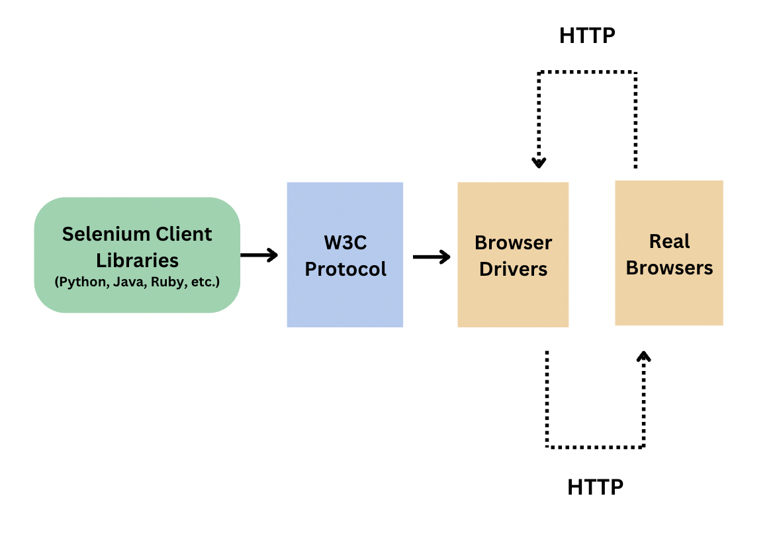
selenium web Driver architecture diagram

Slide 11
WEBDRIVER LOCATORS Selenium WebDriver uses Following locators to find the elements on a webpage. The object identifiers or locators supported by Selenium are Id = driver.findElement(By.id(“Email”)) Name = driver.findElement(By.name(“EmailID”)); Class = driver.findElement(By.className(“mandatory”)); XPath = driver.findElement(By.xpath(“//input[@class=‘login’]”); link Text = driver.findElement(By.linkText(“Gmail”));

Slide 12
Web Element Class Method
Working with elements on a web page can be further enhanced and made easy by Web Element class methods.
The following methods help in acting on elements, retrieving information about elements, and getting positions, size, and visible texts:
clear()
click()
Submit()
SendKeys()
findElement()
getText()
getTagName()
getScreenshotAs()

Slide 13
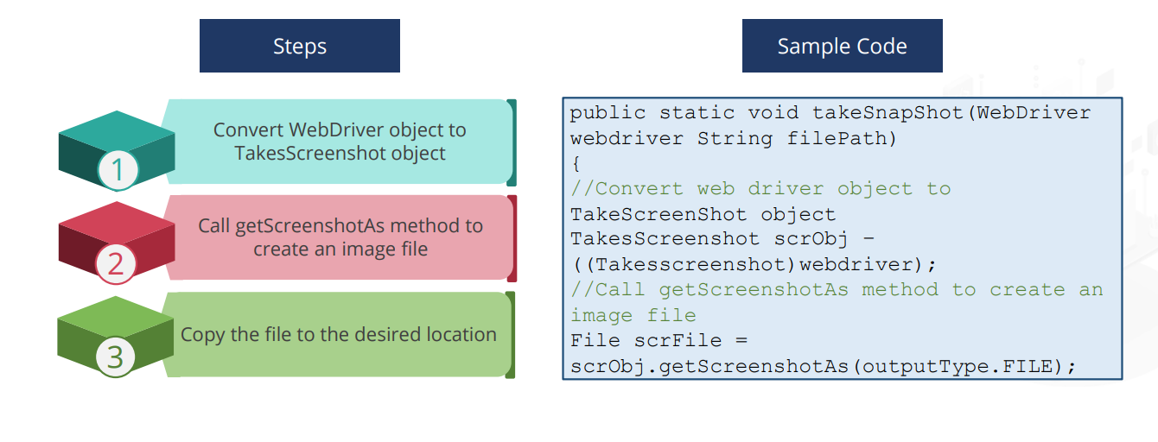
Capturing Screenshots in Selenium
In bug analysis, screenshots are desirable. In automation testing, it is mandatory to take a screenshot for verification of functionality of test cases. Selenium automatically takes screenshots during test execution.
Selenium provides Takes Screenshot interface to capture screenshots
WebDriver instance has to be type casted to Takes Screenshot
Screenshots can be captured in Selenium in 3 simple steps

Slide 14
WHAT IS TESTNG
TestNG (Test Next Generation) is a testing framework for the Java programming language inspired by JUnit and NUnit. It is widely used for test automation, particularly in the Java ecosystem. TestNG provides a more flexible and powerful testing environment compared to JUnit, with additional features that support various testing scenarios.

Slide 15
TestNG Annotations
@BeforeSuite Runs before suite execution starts
@AfterSuite Runs after all tests are executed
@BeforeTest Runs before first test in a tag is executed
@AfterTest Runs after all the tests in a tag are executed
@BeforeGroups Runs before first test method of the group(s) is executed
@AfterGroups Runs after all the test methods of the group(s) are executed
@BeforeClass Runs before first test in a class is executed
@AfterClass Runs after all the tests in a class are executed
@BeforeMethod Runs before each test in a class is executed
@AfterMethod Runs after each test is executed

Slide 16
Assertions In TestNG
Hard Assertion
It stops the program execution if the statement with hard assert fails.
The whole test case fails even if one hard assert fails.
Soft Assertion
Next steps would be executed even if the statement with soft assertion fails
Extra lines of code are required to track the fail status. When used in raw format, failed test step would also yield in Pass test script.

Slide 17
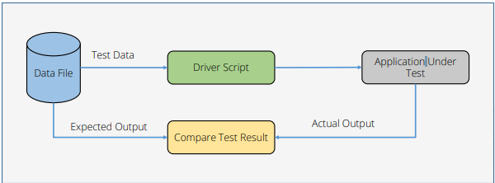
Data-Driven Testing
Data-driven Testing is an automation framework that allows input values to be read from data files and stored into variables in test scripts

Slide 18
Data Provider Annotation: In TestNG, the @DataProvider annotation is used to supply test data to a test method. A method annotated with @DataProvider provides the test data as a two-dimensional array (Object[][]), where each row represents a set of input values. Apache POI is an open source Java library for creating and manipulating various Microsoft Office-based file formats. It is the most commonly used API for Selenium data-driven tests

Slide 19
TestNG Listeners
Listeners are TestNG annotations that literally “listen” to the events in a script and modify TestNG behavior accordingly.
TestNG listeners can be implemented at two levels
1.Class
Listeners are implemented for each class irrespective of the number of test cases.
2.Suite
Listeners are implemented for a particular suite that includes several classes and test cases.
Listeners are implemented by ITestListener interface

Slide 20
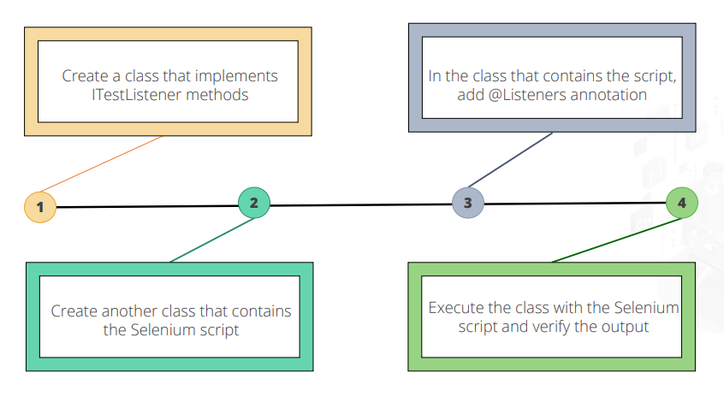
TestNG Listeners: Implementation

Slide 21
CUCUMBER What is Cucumber Cucumber is a software tool that is used to implement Behavior Driven Development (BDD). It uses the language Gherkin to define test cases.

Slide 22
GHERKIN
What is Gherkin
Gherkin is a plain English text language, used in Cucumber, to define test cases. It uses a set of nontechnical keywords that can be easily followed.
Gherkin Keywords
1.Feature:
Describes a high-level feature or functionality of the software. A Gherkin file typically starts with a Feature section.
Ex:- Feature: Login functionality

Slide 23
2.Scenario:
Describes a specific test scenario or use case. Scenarios are often written to represent a single test case.
Ex:-Scenario: User can log in with valid credentials
3.Given: Describes the initial context or preconditions.
4.When: Describes the action or event that triggers the scenario.
5.Then: Describes the expected outcome or result.
Ex:-
Given the user is on the login page
When the user enters valid credentials
Then the user should be logged in successfully

Slide 24
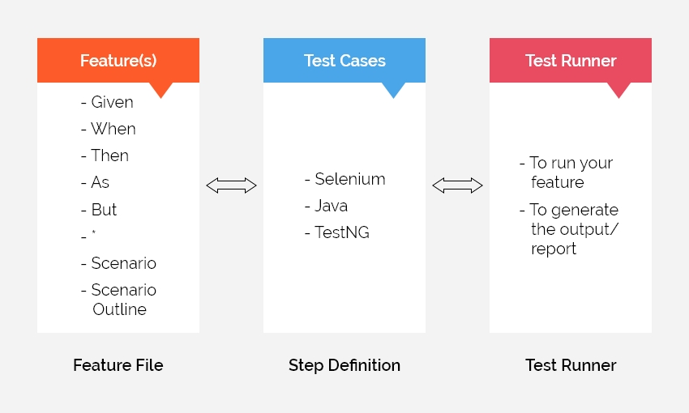
CUCUMBER ARCHITECTURE

Slide 25
Feature File:
A feature file is a plain text file that describes the behavior of the system in a human-readable format. It typically contains scenarios and steps written in Gherkin syntax.
Step Definition File:
The step definition file contains the actual Java code that maps Gherkin steps to executable code. Each Gherkin step is associated with a method in the step definition file.
Runner File:
The runner file is a Java class that configures and runs Cucumber tests. It specifies the location of the feature files, the location of the step definition files, and other configurations.

Slide 26
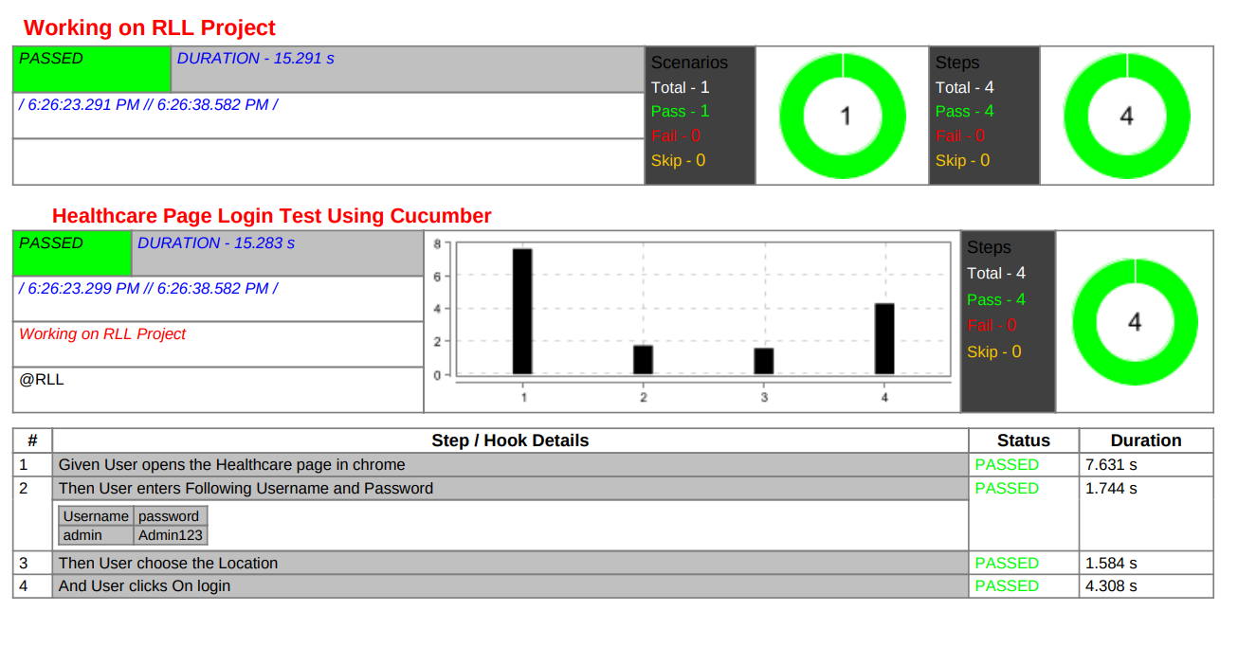
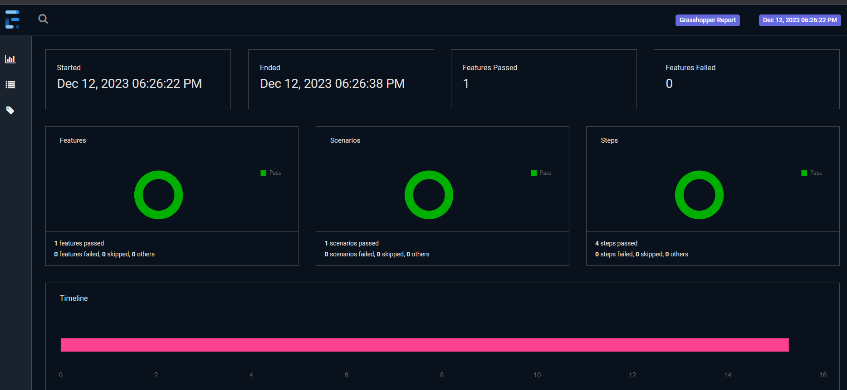
Cucumber and Extent Reports
Extent Report is an open source reporting library for test automation. It generates readable and interactive reports that can be integrated to fit the current test automation framework.

Slide 27
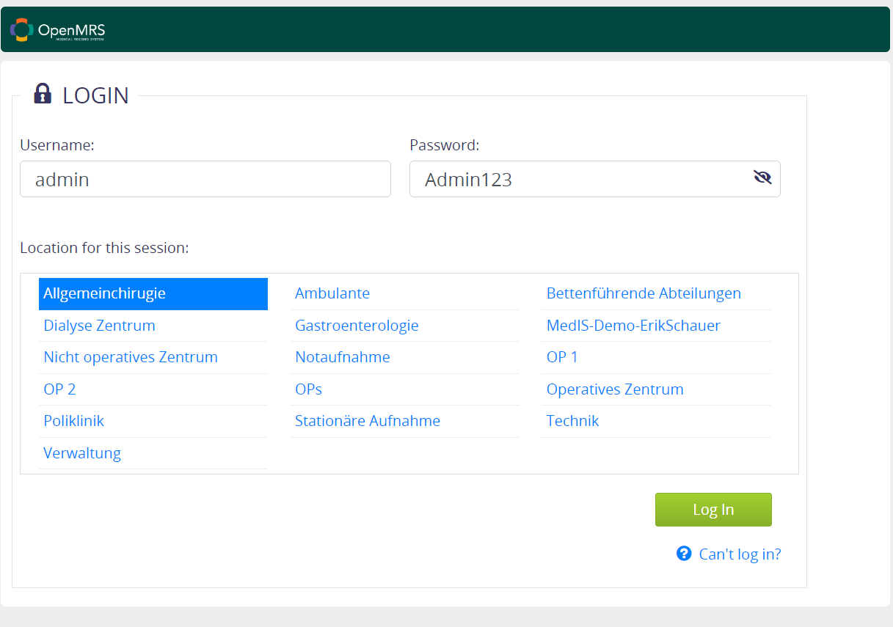
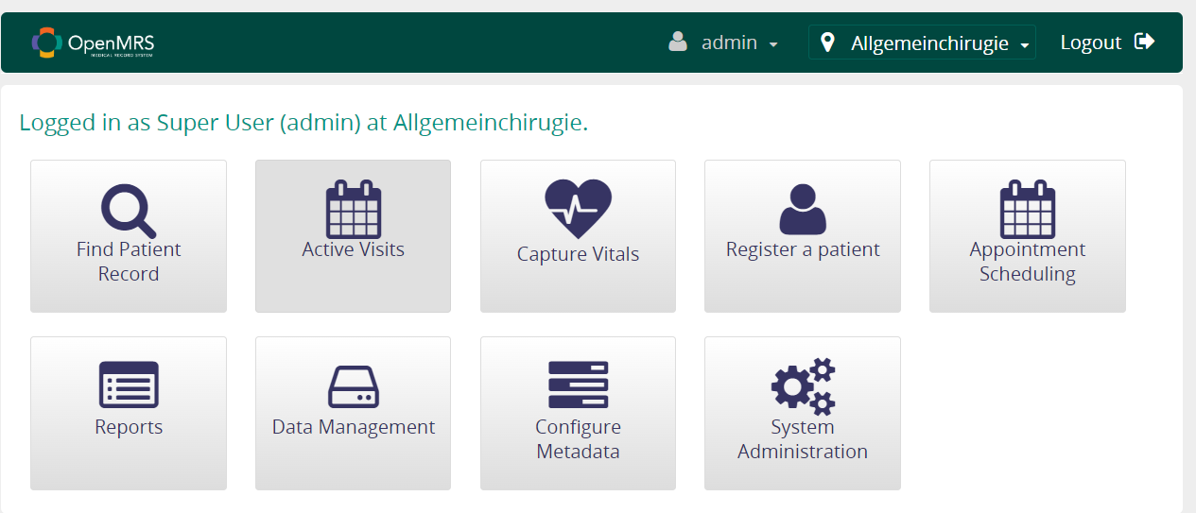

Slide 28
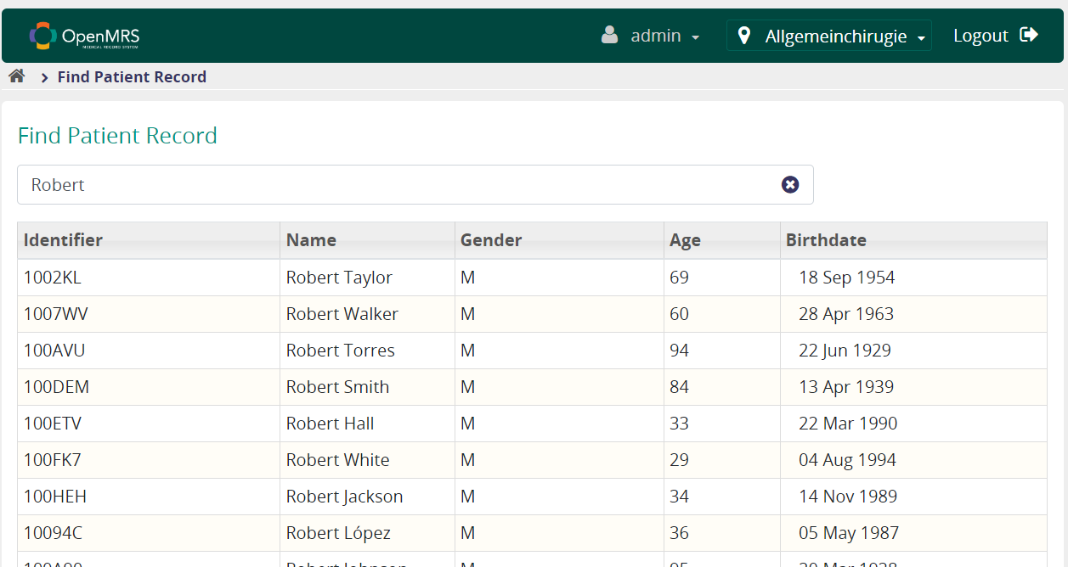
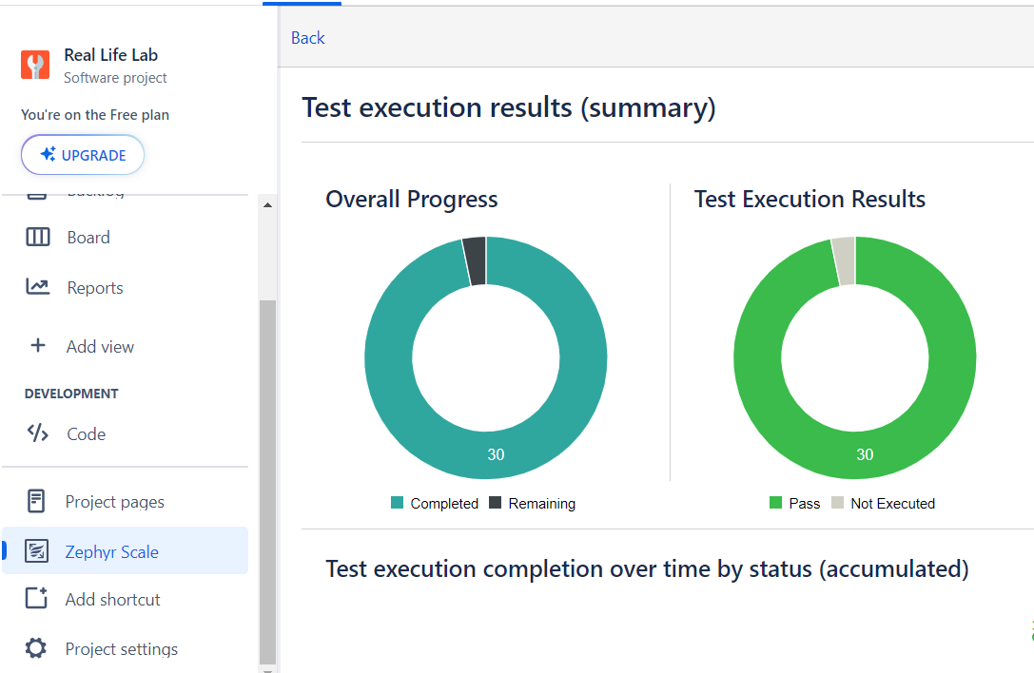

Slide 29
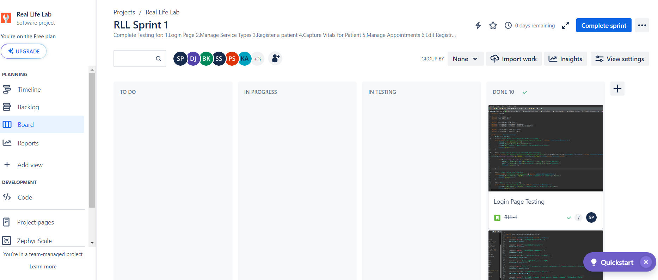

Slide 30
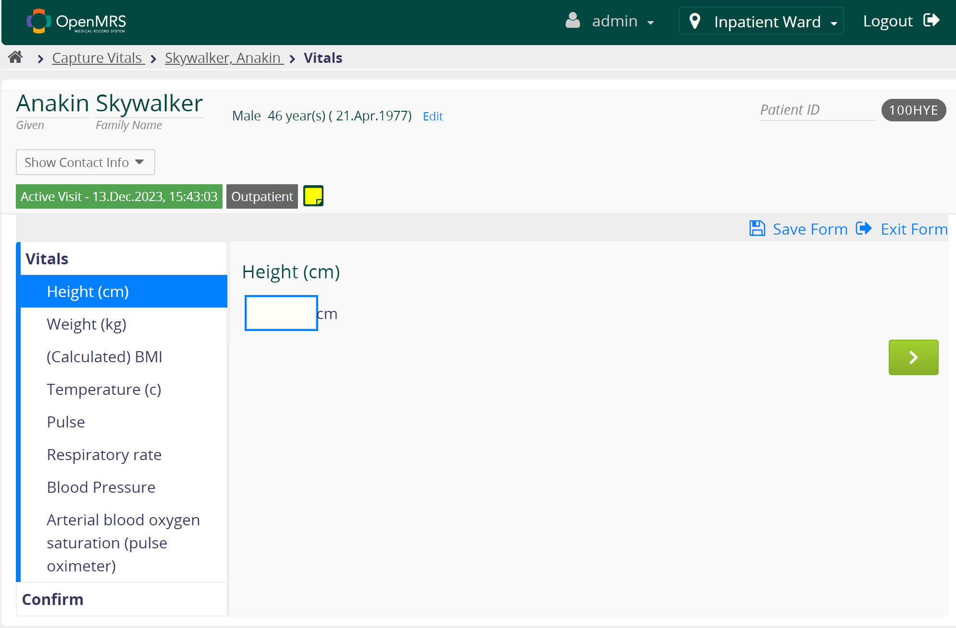

Slide 31
